Slide 1
Introduction to CUDA C

Slide 2
outline
Introduction to CUDA C
A First Program, Hello world
A kernel call
Passing parameters
Querying devices
Using device properties

Slide 3
A First Program
#include "../common/book.h"
int main( void )
{
printf( "Hello, World!\n" );
return 0;
}
-Example illustrates that there is no basic difference between Standard C and Cuda C
- This program runs entirely on Host

Slide 4
A First Program
Host= CPU + System Memory
Device= GPU+ its Memory
A function that executes on the Device is Kernel

Slide 5
Contd..
#include<iostream.h>
_ _global_ _void kernel(void) {
}
Int main(void){
kernel<<<1,1>>>{};
printf(“Hello, World\n”);
return 0;
}
The angle brackets denote arguments are passed to the runtime system.
These are not arguments to the device code but are parameters that will influence how the runtime will launch our device code

Slide 6
Contd..
CUDA C adds the __global__ qualifier to standard C.
This mechanism alerts the compiler that a function should be compiled to run on a device instead of the host.
Example: nvcc gives the function kernel() to the compiler that handles device code, and it feeds main() to the host compiler.
Host code to one compiler and device code to another compiler

Slide 7
Passing Parameter
#include "book.h“
__global__ void add( int a, int b, int *c )
{ *c = a + b;
}
int main( void )
{
int c; int *dev_c;
HANDLE_ERROR( cudaMalloc( (void**)&dev_c, sizeof(int) ) );
add<<1,1>>( 2, 7, dev_c );
HANDLE_ERROR( cudaMemcpy( &c, dev_c, sizeof(int), cudaMemcpyDeviceToHost ) );
printf( "2 + 7 = %d\n", c );
cudaFree( dev_c );
return 0;
}

Slide 8
Contd.
Pass parameters to a kernel as done with any C function.
Allocate memory to do anything useful on a device, such as return values to the host.
Angle-bracket syntax notwithstanding, a kernel call looks and acts exactly like any function call in standard C.
The runtime system takes care of any complexity introduced by the fact that these parameters need to get from the host to the device

Slide 9
Contd.
HANDLE_ERROR(): calls is a utility macro, It simply detects that the call has returned an error, prints the associated error message, and exits the application with an EXIT_FAILURE code.
cudaMalloc():allocation of memory, but it tells the CUDA runtime to allocate the memory on the device.
cudaMalloc( (void**)&dev_c, sizeof(int) )
The first argument is a pointer to the pointer you want to hold the address of the newly allocated memory, and the second parameter is the size of the allocation you want to make.

Slide 10
Contd..
The compiler cannot protect you from this mistake, either. It will be perfectly happy to allow dereferences of device pointers in your host code because it looks like any other pointer in the application. We can summarize the restrictions on the usage of device pointer as follows:
Pass pointers allocated with cudaMalloc() to functions that execute on the device.
Use pointers allocated with cudaMalloc()to read or write memory from code that executes on the device.
Pass pointers allocated with cudaMalloc()to functions that execute on the host.
Cannot use pointers allocated with cudaMalloc()to read or write memory from code that executes on the host

Slide 11
Contd..
cudaMemcpy( void *dst, void *src, size_t nbytes, enum cudaMemcpyKind direction);
cudaMemcpy() :memory on a device through calls to from host code.
These calls behave exactly like standard C memcpy() with an additional parameter to specify which of the source and destination pointers point to device memory.
In the example, notice that the last parameter to cudaMemcpy() is cudaMemcpyDeviceToHost, instructing the runtime that the source pointer is a device pointer and the destination pointer is a host pointer

Slide 12
Contd..
cudaMemcpyHostToDevice would indicate the opposite situation, where the source data is on the host and the destination is an address on the device.
Finally, we can even specify that both pointers are on the device by passing cudaMemcpyDeviceToDevice.
If the source and destination pointers are both on the host, we would simply use standard C’s memcpy() routine to copy between them

Slide 13
Querying devices
cudaGetDeviceCount(): to know how many devices in the system were built on the CUDA architecture. These devices will be capable of executing kernels written in CUDA C.
int count; HANDLE_ERROR( cudaGetDeviceCount( &count ) );
cudaDeviceProp structure returns(see from the textbook)

Slide 14
Device Properties
cudaDeviceProp prop; memset( &prop, 0, sizeof( cudaDeviceProp ) ); prop.major = 1; prop.minor = 3
cudaGetDeviceCount() and cudaGetDeviceProperties(), we could iterate through each device and look for one that either has a major version greater than 1 or has a major version of 1 and minor version greater than or equal to 3

Slide 15
Contd..
cudaChooseDevice() to have the CUDA runtime find a device that satisfies this constraint. The call to cudaChooseDevice() returns a device ID that we can then pass to cudaSetDevice().

Slide 16
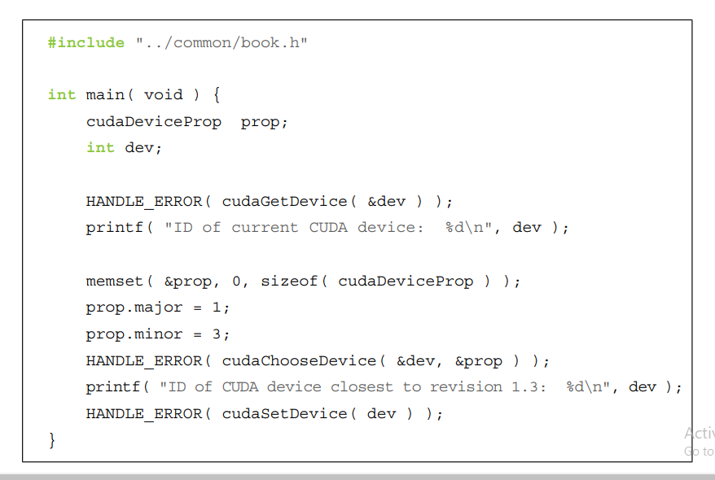

Slide 17
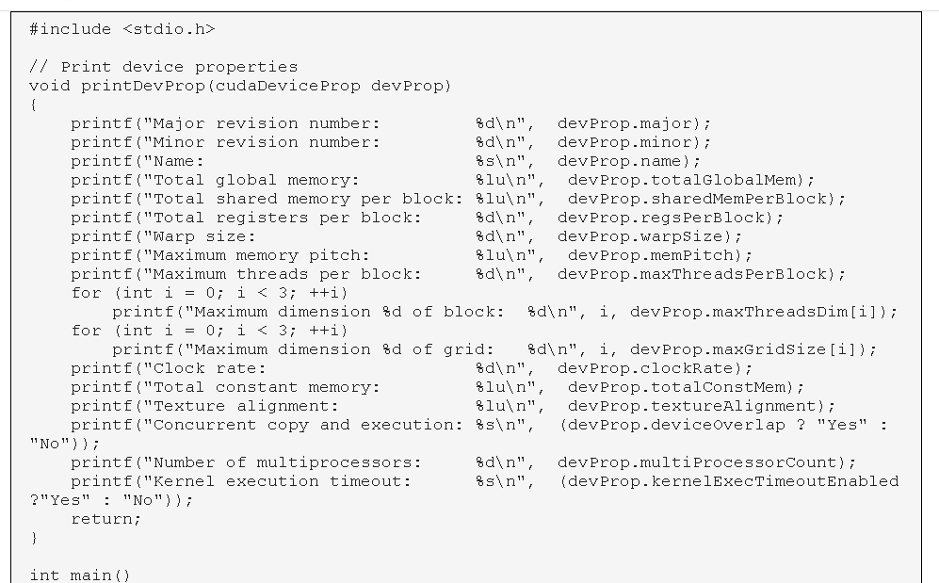

Slide 18
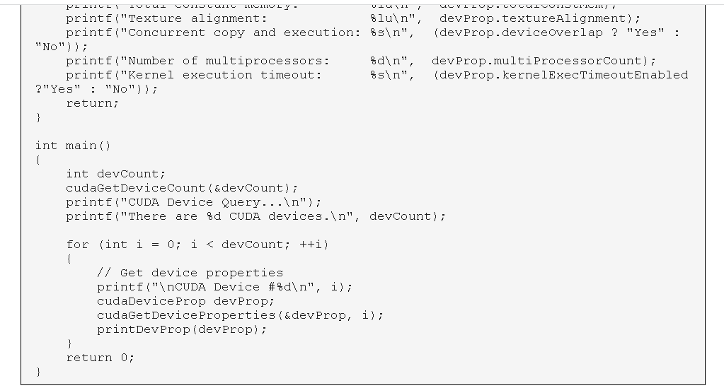

Slide 19
